Slide 1
Exhaustive Search
the maze problem (simplified)

Slide 2
Problem description:
It is given a 2D grid with square unit cells. A rat starts at the top-left cell of the grid and wants to go to the bottom-right cell of the grid where its food is located.
Rat
Some cells with value “-1” are inaccessible to the Rat, he can’ go to or through them.
The Rat can either move one cell Right or Down
Find the total number of ways for the Rat to reach its food.

Slide 3
For example, consider this grid:
0 | 0 | 0 | 0 | -1
0 | -1 | 0 | 0 | 0
0 | 0 | 0 | 0 | 0
-1 | 0 | 0 | 0 | 0

Slide 4
For example, consider this grid:
0 | 0 | 0 | 0 | -1
0 | -1 | 0 | 0 | 0
0 | 0 | 0 | 0 | 0
-1 | 0 | 0 | 0 | 0
Start
Finish

Slide 5
For example, consider this grid:
0 | 0 | 0 | 0 | -1
0 | -1 | 0 | 0 | 0
0 | 0 | 0 | 0 | 0
-1 | 0 | 0 | 0 | 0
Start
One way
Finish

Slide 6
For example, consider this grid:
0 | 0 | 0 | 0 | -1
0 | -1 | 0 | 0 | 0
0 | 0 | 0 | 0 | 0
-1 | 0 | 0 | 0 | 0
Start
Finish
Another way

Slide 7
For example, consider this grid:
0 | 0 | 0 | 0 | -1
0 | -1 | 0 | 0 | 0
0 | 0 | 0 | 0 | 0
-1 | 0 | 0 | 0 | 0
Start
Another way
Finish

Slide 8
Designing the algorithm:
The Rat has 2 Choices
Either Go:
Right
Down

Slide 9
There are 3 Stopping Conditions:
1. The Rat Goes out of Borders.
2. The Rat Goes to a Cell -1
3. The Rat reaches its Destination.

Slide 10
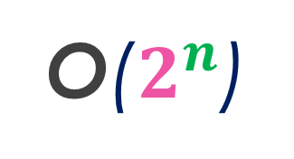
The code representation:
function MazeRat(i, j, m, n, Maze)
if i < 0 or j < 0 or (i equals m) or (j equals n) then
return 0
end if
if Maze[i][j] equals -1 then
return 0
end if
if (i equals m-1) and (j equals n -1) then
return 1
end if
a ← MazeRat(i + 1, j, m, n, Maze)
b ← MazeRat(i, j + 1, m, n, Maze)
return a + b
end function
Stopping if out of borders
Stopping if going through a forbidden cell
Counting if destination reached
Going Down
O($2^{n}$)
Going Right

Slide 11
Are there any overlapping cases?
0 | 0 | 0 | 0 | -1
0 | -1 | 0 | 0 | 0
0 | 0 | 0 | 0 | 0
-1 | 0 | 0 | 0 | 0
Start
Finish

Slide 12
Are there any overlapping cases?
0 | 0 | 0 | 0 | -1
0 | -1 | 0 | 0 | 0
0 | 0 | 0 | 0 | 0
-1 | 0 | 0 | 0 | 0
Start
Watch this
sub-path
Finish

Slide 13
Are there any overlapping cases?
0 | 0 | 0 | 0 | -1
0 | -1 | 0 | 0 | 0
0 | 0 | 0 | 0 | 0
-1 | 0 | 0 | 0 | 0
Start
Watch this
sub-path
Finish

Slide 14
Are there any overlapping cases?
0 | 0 | 0 | 0 | -1
0 | -1 | 0 | 0 | 0
0 | 0 | 0 | 0 | 0
-1 | 0 | 0 | 0 | 0
Start
Watch this
sub-path
Finish

Slide 15
Are there any overlapping cases?
0 | 0 | 0 | 0 | -1
0 | -1 | 0 | 0 | 0
0 | 0 | 0 | 0 | 0
-1 | 0 | 0 | 0 | 0
Start
Watch this
sub-path
Finish

Slide 16
Are there any overlapping cases?
0 | 0 | 0 | 0 | -1
0 | -1 | 0 | 0 | 0
0 | 0 | 0 | 0 | 0
-1 | 0 | 0 | 0 | 0
Start
Watch this
sub-path
Finish

Slide 17
Repeated many times!!
Since we don’t need to show the paths, we can save the sum of paths.
Let’s use a Memo matrix with the same dimensions as the Maze
Memo[m][n]

Slide 18
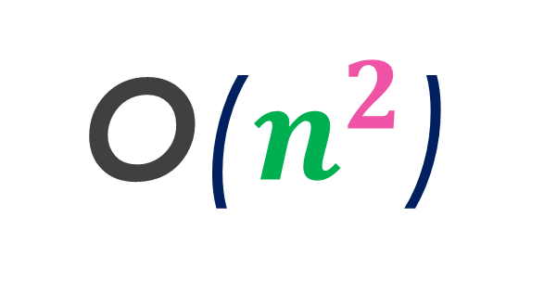
function MazeRat(i, j, m, n, Maze, Memo)
if i < 0 or j < 0 or (i equals m) or (j equals n) then
return 0
end if
if Maze[i][j] equals -1 then
return 0
end if
if (i equals m-1) and (j equals n -1) then
return 1
end if
if Memo[i][j] is visited then
return Memo[i][j]
end if
a ← MazeRat(i + 1, j, m, n, Maze)
b ← MazeRat(i, j + 1, m, n, Maze)
Memo[i][j] ← a + b
return Memo[i][j]
end function
The code becomes:
O($n^{2}$)
Stopping if having counted for that cell
This operation happens only once for each cell

Slide 19
Thank you!
To be continued…

